Slide 1

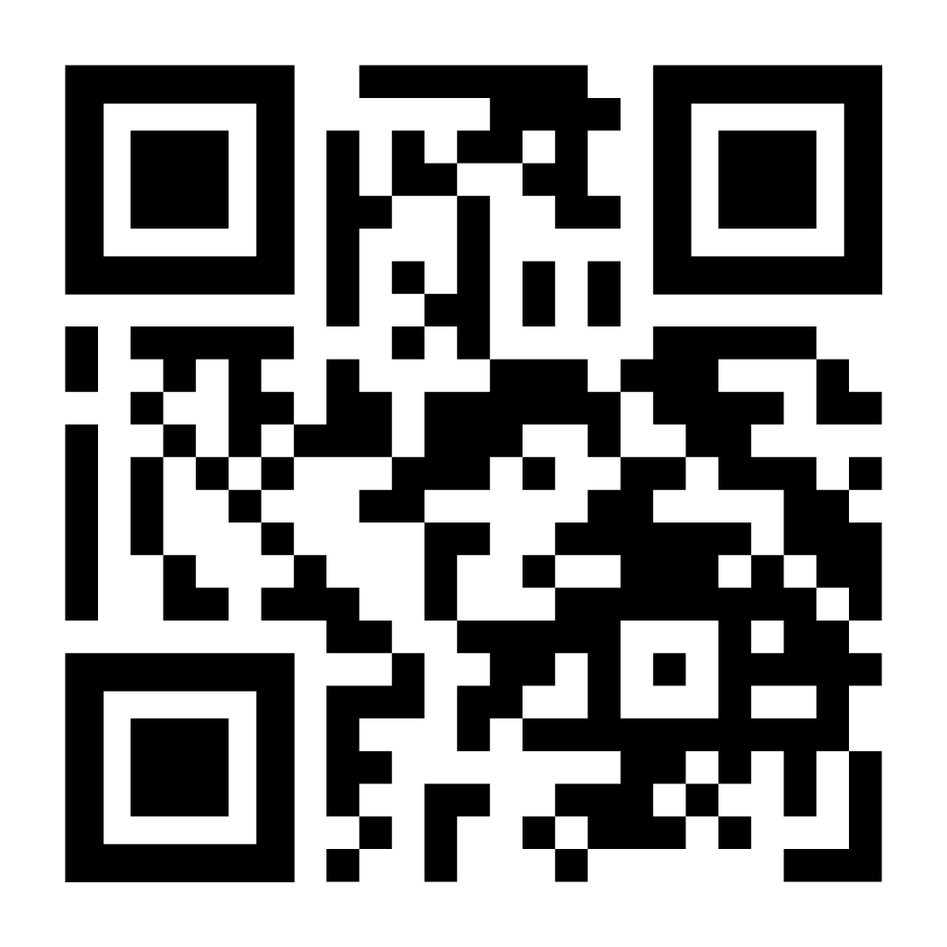
WHEN YOUR CHILD TURNS 18
HIPAA, Medical Decisions, and Essential Texas Planning
MONTGOMERY COUNTY AGGIE MOMS CLUB
J. Thad Whisenant
Board Certified in Family Law
Parkwood Two | 10055 Grogans Mill Rd., Suite 130 | The Woodlands, Texas 77380
281-681-8889 | jtwlawoffice.com | twhisenant@jtwlawoffice.com
SCAN FOR FIRM WEBSITE
Notes:
Welcome, and thank you for having me. Today is not about taking control away from our children; it is about helping adult students decide in advance who can receive information, who can help, and who can speak if the student cannot. This is general education, not individual legal advice. The QR code goes to our firm website and the final resource slide contains free Texas A&M and Texas resources.

Slide 2
THE AGE-18 LEGAL SHIFT
THE BIRTHDAY THAT CHANGES THINGS
At age 18, your child becomes a legal adult—even if still in high school, living at home, financially dependent, or covered by your health insurance.
Parents do not automatically have a legal right to medical information or authority to make health-care decisions.
Planning is not about taking control. It is about allowing your adult student to choose who can help in an emergency.
J. THAD WHISENANT | BOARD CERTIFIED IN FAMILY LAW
10055 GROGANS MILL RD., SUITE 130, THE WOODLANDS, TX 77380 | 281-681-8889 | JTWLAWOFFICE.COM
Notes:
The change happens at 18, not at college move-in. A student may still be in high school, live at home, and be on a parent’s health insurance, but the student is generally the adult decision-maker. That is why I encourage families to have the conversation before the eighteenth birthday or before a student leaves for college.

Slide 3
A REAL-WORLD SCENARIO
THE QUESTION PARENTS ASK FIRST
Your adult student is in an emergency room, is alert, and the physician needs to discuss care; you pay the insurance premium and are listed as the emergency contact.
Question: Can the hospital tell you what happened, discuss treatment with you, or release records to you?
The first practical issue is usually communication—not decision-making.
J. THAD WHISENANT | BOARD CERTIFIED IN FAMILY LAW
10055 GROGANS MILL RD., SUITE 130, THE WOODLANDS, TX 77380 | 281-681-8889 | JTWLAWOFFICE.COM
Notes:
Start with a realistic situation. The student is conscious in the ER. The parent is paying the bill and is the emergency contact. The question is not necessarily who makes the decision; the first question is whether the provider can speak with the parent and share information. That is where HIPAA planning becomes immediately useful.

Slide 4
WHAT HIPAA DOES
HEALTH INSURANCE PORTABILITY AND ACCOUNTABILITY ACT (HIPAA)
The Health Insurance Portability and Accountability Act (HIPAA) is a federal privacy law that generally controls how covered health-care providers and health plans may use or disclose protected health information.
A HIPAA authorization allows the adult student to identify who may receive information and communicate with providers.
A well-drafted authorization can permit discussion of diagnosis, treatment, records, insurance, and related questions with the people the student names.
It can be effective immediately—even while the student remains capable of making their own decisions.
J. THAD WHISENANT | BOARD CERTIFIED IN FAMILY LAW
10055 GROGANS MILL RD., SUITE 130, THE WOODLANDS, TX 77380 | 281-681-8889 | JTWLAWOFFICE.COM
Notes:
HIPAA stands for the Health Insurance Portability and Accountability Act. In simple terms, it is a federal privacy framework for protected health information held by covered providers and health plans. A student can authorize providers to talk with named parents or other trusted people. This is often the practical document a parent will rely on first. Note that Texas A&M University Health Services treatment records are generally governed by FERPA rather than HIPAA, so the university has its own records-release process.

Slide 5
IMPORTANT LIMITS
WHAT HIPAA DOES NOT DO
It does not authorize a parent to consent to, refuse, or direct medical treatment.
It does not let a parent override the choices of a competent adult student.
It does not replace a Medical Power of Attorney.
The student should decide intentionally on scope, sensitive information, duration, and how to revoke the authorization.
J. THAD WHISENANT | BOARD CERTIFIED IN FAMILY LAW
10055 GROGANS MILL RD., SUITE 130, THE WOODLANDS, TX 77380 | 281-681-8889 | JTWLAWOFFICE.COM
Notes:
Keep the distinction simple: HIPAA is information and communication, not decision-making. The student remains in charge while capable. The student should think carefully about who is named and whether the authorization should include sensitive categories of information. The goal is intentional consent, not a blanket loss of privacy.

Slide 6
TWO DIFFERENT JOBS
HIPAA VS. MEDICAL POWER OF ATTORNEY
Question
HIPAA Authorization
Medical Power of Attorney
Can a provider speak with me?
Yes—if the student authorizes disclosure.
Not necessarily by itself.
Can I discuss care and receive records?
Yes—within the authorization’s scope.
Not necessarily while the student is capable.
Can I make treatment decisions?
No.
Yes—after incapacity and the MPOA trigger.
Who remains in control while capable?
The adult student.
The adult student.
HIPAA answers “Who can receive information?” • MPOA answers “Who can decide if I cannot?”
J. THAD WHISENANT | BOARD CERTIFIED IN FAMILY LAW
10055 GROGANS MILL RD., SUITE 130, THE WOODLANDS, TX 77380 | 281-681-8889 | JTWLAWOFFICE.COM
Notes:
This comparison is the heart of the presentation. HIPAA answers: who can receive information and communicate with providers? A Medical Power of Attorney answers: who can decide if the student cannot decide? Both are useful, but they solve different problems. Neither lets a parent overrule a capable adult student.

Slide 7
COMMON PARENT ASSUMPTIONS
MISCONCEPTION CHECK
MYTH
“I pay the insurance premium, so the doctor must speak with me.”
REALITY
Payment responsibility does not automatically create access to an adult child’s protected health information.
A HIPAA authorization is the practical way for the student to authorize communication with parents or other trusted people.
J. THAD WHISENANT | BOARD CERTIFIED IN FAMILY LAW
10055 GROGANS MILL RD., SUITE 130, THE WOODLANDS, TX 77380 | 281-681-8889 | JTWLAWOFFICE.COM
Notes:
Ask the room for a quick show of hands or pause: How many parents have heard this statement? Paying the premium does not by itself create a right to protected information. A HIPAA authorization is the practical solution when the student wants a parent involved.

Slide 8
COMMON PARENT ASSUMPTIONS
MISCONCEPTION CHECK
MYTH
“My child is still in high school, so I can make medical decisions.”
REALITY
At 18, a child is generally a legal adult for health-care decision-making.
A Medical Power of Attorney becomes important if the student cannot make decisions and its incapacity trigger is satisfied.
J. THAD WHISENANT | BOARD CERTIFIED IN FAMILY LAW
10055 GROGANS MILL RD., SUITE 130, THE WOODLANDS, TX 77380 | 281-681-8889 | JTWLAWOFFICE.COM
Notes:
This is often the surprise for parents of high-school seniors. The legal transition occurs at 18. A Medical Power of Attorney can matter if the student cannot make decisions and the document’s legal trigger is satisfied. It is not authority to manage a capable child’s care.

Slide 9
COMMON PARENT ASSUMPTIONS
MISCONCEPTION CHECK
MYTH
“Being an emergency contact gives me legal authority.”
REALITY
An emergency contact is someone the school or provider may call—not automatically a person with access or decision-making authority.
A HIPAA authorization and a Medical Power of Attorney each serve separate legal purposes.
J. THAD WHISENANT | BOARD CERTIFIED IN FAMILY LAW
10055 GROGANS MILL RD., SUITE 130, THE WOODLANDS, TX 77380 | 281-681-8889 | JTWLAWOFFICE.COM
Notes:
Being listed as an emergency contact is important, but limited. It tells the school or provider whom to call. It does not automatically make that person the recipient of medical records or the person authorized to make treatment choices.

Slide 10
COMMON PARENT ASSUMPTIONS
MISCONCEPTION CHECK
MYTH
“HIPAA authorization and Medical Power of Attorney are the same document.”
REALITY
They do different jobs: HIPAA permits information access; a Medical Power of Attorney can permit decisions during incapacity.
For parents, the HIPAA authorization is often the document used first; the Medical Power of Attorney addresses a more serious incapacity event.
J. THAD WHISENANT | BOARD CERTIFIED IN FAMILY LAW
10055 GROGANS MILL RD., SUITE 130, THE WOODLANDS, TX 77380 | 281-681-8889 | JTWLAWOFFICE.COM
Notes:
Use this slide to reinforce the two-document idea. HIPAA is usually the access-and-communication tool. The Medical Power of Attorney is the incapacity decision-making tool. Parents often need both concepts explained, but the student decides what to execute and whom to name.

Slide 11
COMMON PARENT ASSUMPTIONS
MISCONCEPTION CHECK
MYTH
“A general financial power of attorney covers medical decisions.”
REALITY
A Statutory Durable Power of Attorney addresses financial and property matters—not health-care decisions.
Health-care decisions require the appropriate medical-planning document, such as a Medical Power of Attorney.
J. THAD WHISENANT | BOARD CERTIFIED IN FAMILY LAW
10055 GROGANS MILL RD., SUITE 130, THE WOODLANDS, TX 77380 | 281-681-8889 | JTWLAWOFFICE.COM
Notes:
A Statutory Durable Power of Attorney is for financial and property matters. It is not the medical document. For this talk, the takeaway is simple: do not assume a general financial power covers health-care decisions.

Slide 12
DECISIONS DURING INCAPACITY
MEDICAL POWER OF ATTORNEY
The adult student appoints a trusted primary agent and preferably at least one successor agent.
A Medical Power of Attorney authorizes health-care decisions only if the student cannot make them and the statutory incapacity trigger is met.
The agent must follow the student’s stated wishes, values, and any limitations in the document.
A competent adult student keeps the right to make—and refuse—health-care decisions.
J. THAD WHISENANT | BOARD CERTIFIED IN FAMILY LAW
10055 GROGANS MILL RD., SUITE 130, THE WOODLANDS, TX 77380 | 281-681-8889 | JTWLAWOFFICE.COM
Notes:
The student chooses a primary agent and, ideally, a successor. The agent’s duty is to follow the student’s wishes and values. The student still controls decisions while capable. Encourage the student to select someone who is calm, reachable, trustworthy, and willing to act.

Slide 13
WHAT FERPA COVERS
FAMILY EDUCATIONAL RIGHTS AND PRIVACY ACT (FERPA)
The Family Educational Rights and Privacy Act (FERPA) is the federal law that protects education records held by Texas A&M University.
Once a student attends college, FERPA rights belong to the student—not the parent—even if the parent pays tuition or claims the student as a tax dependent.
FERPA can cover grades, academic standing, course schedules, disciplinary information, financial-aid information, and other university education records.
FERPA differs from HIPAA: FERPA governs university education records; HIPAA generally governs health information held by covered health-care providers.
J. THAD WHISENANT | BOARD CERTIFIED IN FAMILY LAW
10055 GROGANS MILL RD., SUITE 130, THE WOODLANDS, TX 77380 | 281-681-8889 | JTWLAWOFFICE.COM
Notes:
Now we change from health records to school records. FERPA is the Family Educational Rights and Privacy Act. It is the federal law governing education records held by the university. At the college level, the rights generally belong to the student, even if a parent pays tuition or claims the student as a dependent. Keep FERPA separate from HIPAA in the audience’s mind.

Slide 14
TEXAS A&M DEFAULT FOR DIRECTORY INFORMATION
FERPA: DIRECTORY INFORMATION IS OPT-OUT
Texas A&M designates certain information as “directory information,” including the student’s name, UIN, local and permanent address, email address, and telephone numbers.
The default position for directory information is opt-out: Texas A&M may release designated directory information without prior written consent unless the student places a directory hold.
“May release” does not mean that Texas A&M must release the information.
Grades and GPA are not directory information; their disclosure generally requires written consent or a valid FERPA exception.
J. THAD WHISENANT | BOARD CERTIFIED IN FAMILY LAW
10055 GROGANS MILL RD., SUITE 130, THE WOODLANDS, TX 77380 | 281-681-8889 | JTWLAWOFFICE.COM
Notes:
For Texas A&M directory information, the default is opt-out. That means Texas A&M may release designated directory information unless the student places a directory hold. Examples include contact information. ‘May release’ does not mean ‘must release.’ Grades and GPA are not directory information.

Slide 15
PARENT ACCESS: IMPORTANT NUANCE
FERPA: NON-DIRECTORY RECORDS ARE GENERALLY OPT-IN
For non-directory education records—such as grades, GPA, disciplinary records, and most financial-aid information—Texas A&M generally needs the student’s written consent before disclosure to a parent or another third party, unless a FERPA exception applies.
A dependency exception may permit disclosure to a parent or legal guardian if the student is a financial dependent under Internal Revenue Code § 152.
That exception is not broad or automatic parent access, and it is not an emergency communication plan.
Qualifying health-and-safety emergencies may permit disclosure under FERPA, but families should not rely on an emergency exception as their plan.
J. THAD WHISENANT | BOARD CERTIFIED IN FAMILY LAW
10055 GROGANS MILL RD., SUITE 130, THE WOODLANDS, TX 77380 | 281-681-8889 | JTWLAWOFFICE.COM
Notes:
For non-directory records, the general rule is the opposite: disclosure is generally opt-in through student consent unless an exception applies. Texas A&M may have a dependency exception for a qualifying tax-dependent student, but families should not count on that as broad, automatic access. Nor should they rely on an emergency exception as their plan.

Slide 16
HOWDY DIRECTORY-HOLD PROCESS
FERPA: HOW A STUDENT CONTROLS DIRECTORY INFORMATION
A currently enrolled Texas A&M student can use Howdy to place a directory-information hold.
In Howdy: search “directory holds” → open the Directory Information Holding Form → select the items to restrict → click “Update Directory Holds.”
The hold limits directory-information disclosure; it does not give a parent access to grades, academic records, or other non-directory information.
The hold remains in effect until the student revokes it or dies.
J. THAD WHISENANT | BOARD CERTIFIED IN FAMILY LAW
10055 GROGANS MILL RD., SUITE 130, THE WOODLANDS, TX 77380 | 281-681-8889 | JTWLAWOFFICE.COM
Notes:
This is a practical slide. Students can manage directory restrictions through the authenticated Howdy system: search ‘directory holds,’ open the Directory Information Holding Form, choose the items to restrict, and save. A directory hold restricts selected directory information; it does not grant a parent access to grades or other non-directory records.

Slide 17
A FOCUSED, NOT OVERWHELMING, PLAN
RELATED DOCUMENTS TO KNOW
Directive to Physicians: expresses preferences about life-sustaining treatment in specified serious medical circumstances.
FERPA consent: may permit the university to discuss specified education records; it is different from HIPAA.
Statutory Durable Power of Attorney: covers financial and property matters—not health-care decisions.
Emergency information sheet: insurance, medications, allergies, providers, emergency contacts, and secure document location.
J. THAD WHISENANT | BOARD CERTIFIED IN FAMILY LAW
10055 GROGANS MILL RD., SUITE 130, THE WOODLANDS, TX 77380 | 281-681-8889 | JTWLAWOFFICE.COM
Notes:
Do not overwhelm families with forms. The key is to understand the function of each document. A Directive to Physicians concerns serious end-of-life treatment preferences. A FERPA consent concerns university education records. A financial power concerns property and financial matters. An emergency information sheet is not legal, but it can be extremely useful in a crisis.

Slide 18
FIVE STEPS
A SIMPLE ACTION CHECKLIST
Have the conversation before move-in day—or as soon as the student turns 18.
Use credible free resources, such as Texas A&M Student Legal Services, Student Life notary services, University Health Services, Texas HHS, and TexasLawHelp.
Let the adult student choose the people, scope, and documents that fit their wishes.
Keep signed originals, accessible copies, and emergency information available to the student, designated agents, and other people the student chooses to involve.
Review the plan after a major health, family, school, or travel change.
J. THAD WHISENANT | BOARD CERTIFIED IN FAMILY LAW
10055 GROGANS MILL RD., SUITE 130, THE WOODLANDS, TX 77380 | 281-681-8889 | JTWLAWOFFICE.COM
Notes:
This is the practical checklist. Make it a student-led conversation. Use the free resources listed here. Keep the original, accessible copies, and emergency information where the student and the right people can find them. Review the plan after a major family, health, school, or travel change.

Slide 19
WHERE STUDENTS CAN START
TEXAS A&M AND TEXAS RESOURCES
Student Legal Services: appointments/intake at studentlife.tamu.edu/program-areas/sls-intake/; phone 979-862-4502; text 979-318-5086; studentlegalservices@tamu.edu.
Student Life notary and power-of-attorney information: studentlife.tamu.edu/faqs/.
University Health Services: uhs.tamu.edu; 979-458-4584. Student treatment records are generally governed by FERPA, not HIPAA.
Office of the Registrar FERPA information: registrar.tamu.edu/ferpa/. Directory holds are managed in the student’s authenticated Howdy account.
J. THAD WHISENANT | BOARD CERTIFIED IN FAMILY LAW
10055 GROGANS MILL RD., SUITE 130, THE WOODLANDS, TX 77380 | 281-681-8889 | JTWLAWOFFICE.COM
Notes:
These are free starting points. Texas A&M Student Legal Services can help students access legal advice; Student Life provides notary and power-of-attorney information. University Health Services can address its own records-release and advance-directive information. The Registrar’s FERPA materials and Howdy directory holds address school-record privacy. Encourage students to use the QR codes or take a photograph of this slide.

Slide 20
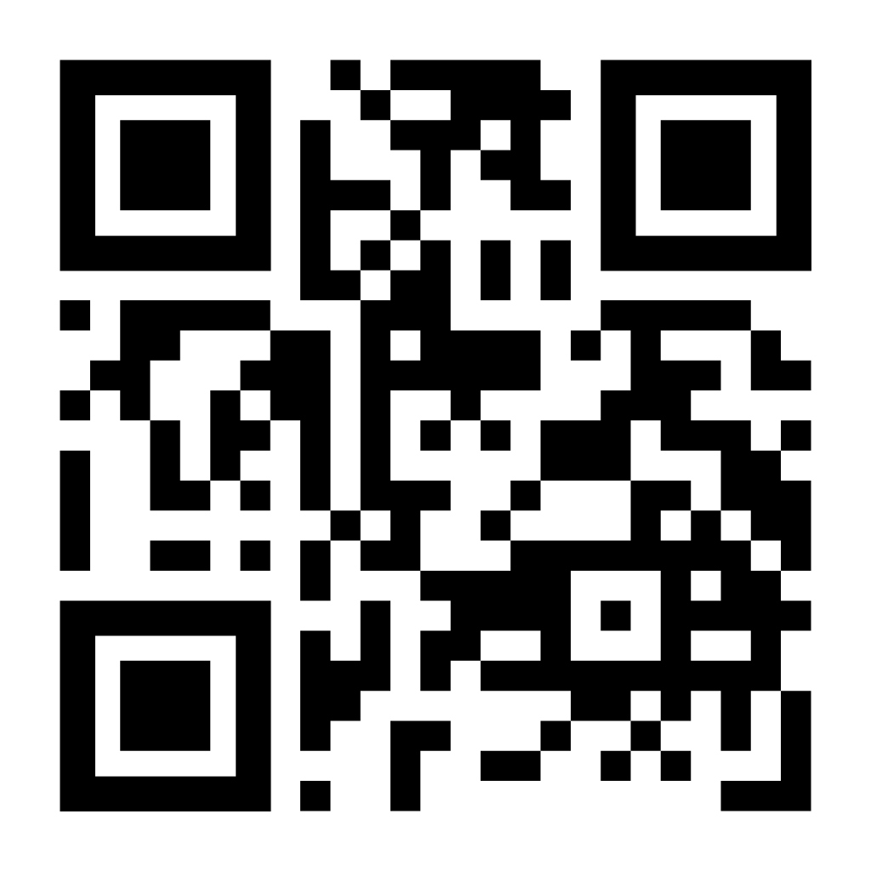
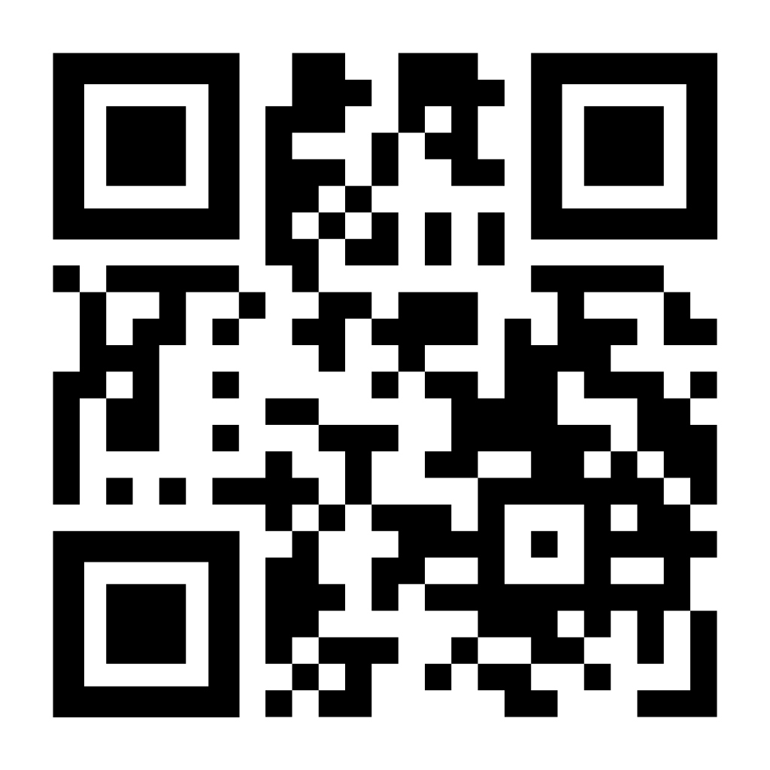
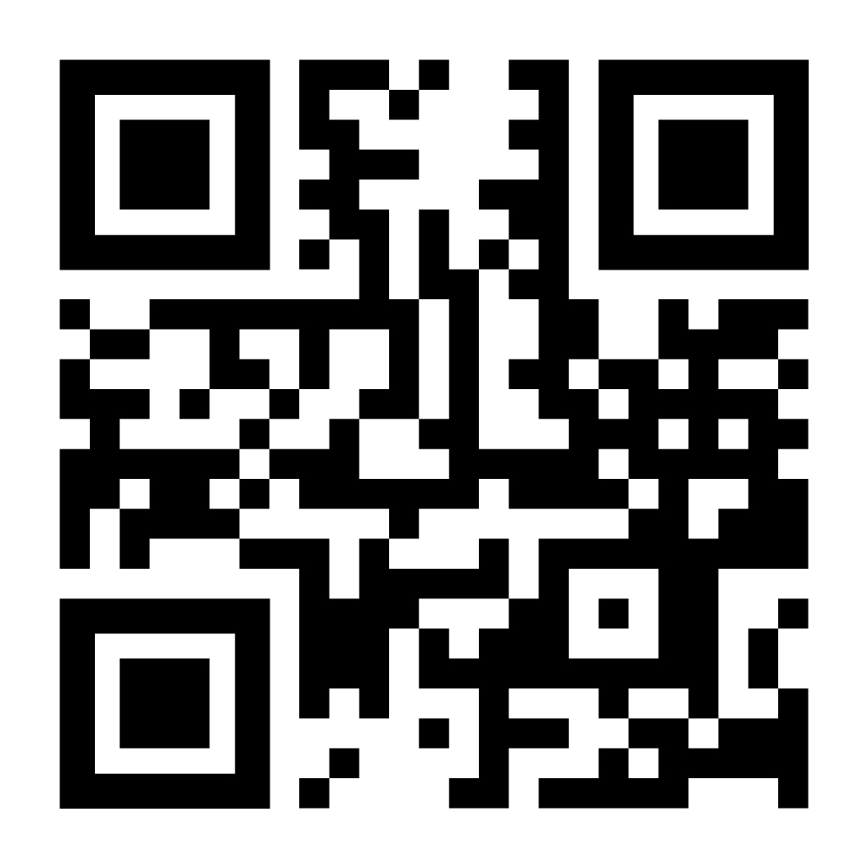
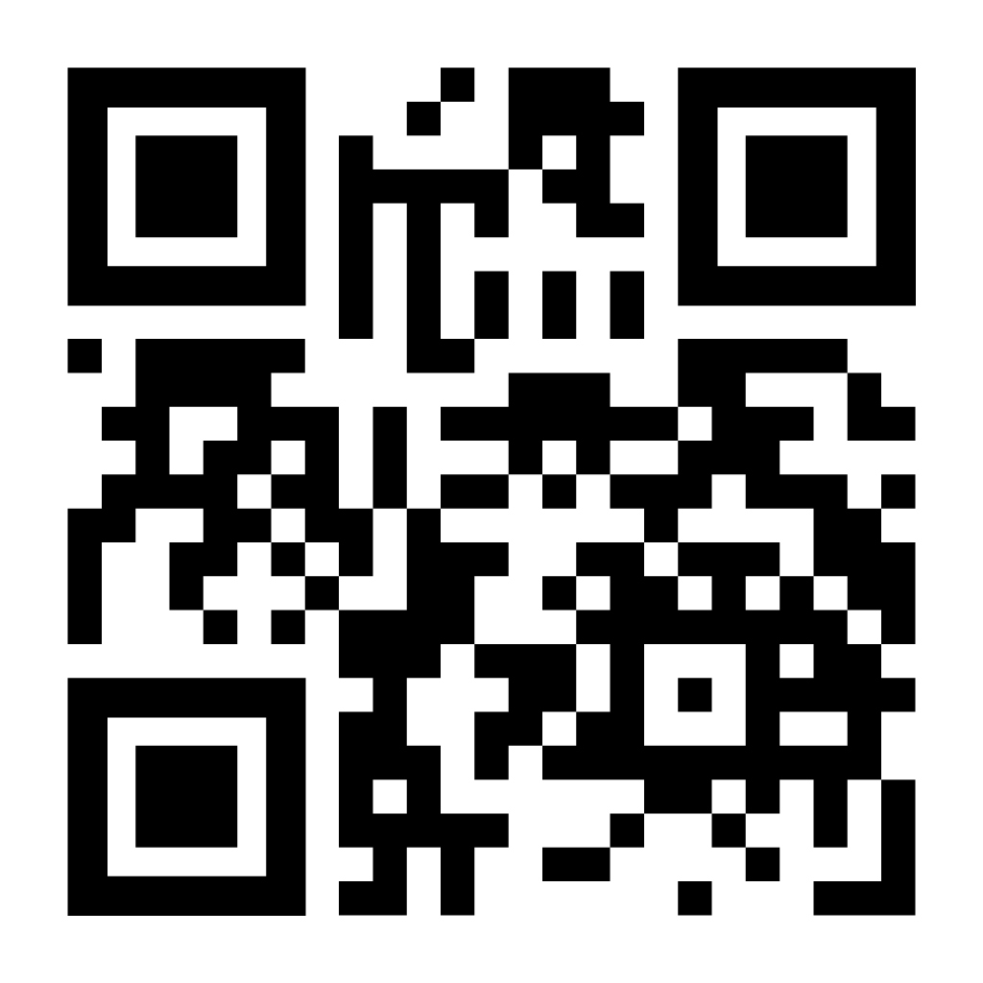
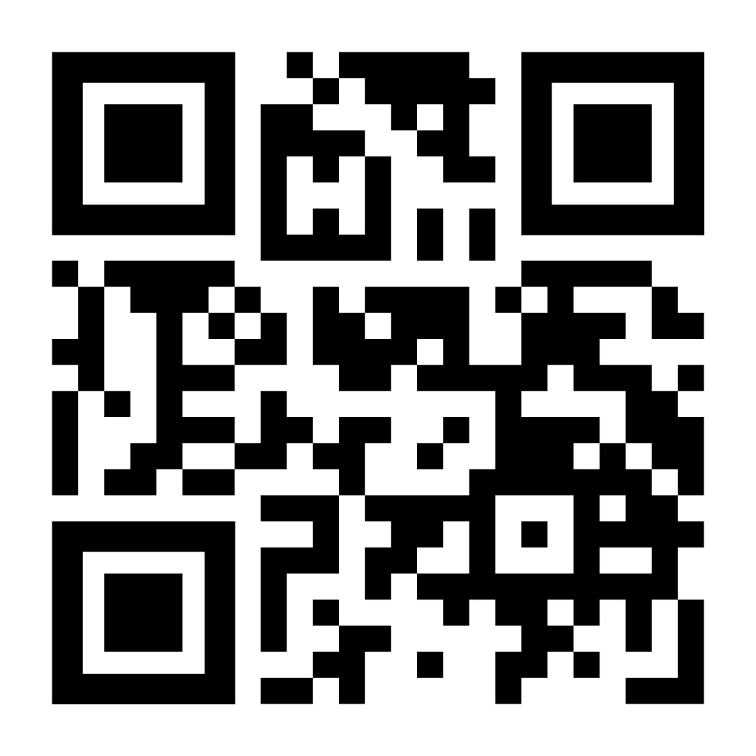
SCAN AND SAVE
FREE TEXAS A&M & TEXAS RESOURCES
Each QR code links directly to the official source. Choose the resource most useful to your student.
Student Legal
Services
Student Life
Notary & POA Info
University Health
Services
Texas HHS
Advance Directives
TexasLawHelp
Medical POA
Free student legal-advice and appointment resource
Notary information and power-of-attorney guidance
Privacy, records-release, and advance-directive information
Official Texas advance-directive information
Plain-language Medical Power of Attorney resource
SCAN
SCAN
SCAN
SCAN
SCAN
J. THAD WHISENANT | BOARD CERTIFIED IN FAMILY LAW
10055 GROGANS MILL RD., SUITE 130, THE WOODLANDS, TX 77380 | 281-681-8889 | JTWLAWOFFICE.COM
Notes:
Please take a photo of this slide now if helpful. Each QR code goes to the official resource identified below it. These are intended to help students understand their options and locate the right campus or state resource; they are not a substitute for individualized advice in a complex situation.

Slide 21
PREPARE EARLY.
RESPECT THEIR AUTONOMY.
AVOID UNCERTAINTY.
Your student decides who may receive information, who may speak for them, and how family can help in a crisis.
SCAN FOR FIRM WEBSITE
J. Thad Whisenant | Board Certified in Family Law | 281-681-8889 | www.jtwlawoffice.com
Notes:
Close with the theme: prepare early, respect the student’s autonomy, and avoid uncertainty. The goal is not to frighten parents or make every family execute every document. It is to ensure that an adult student’s choices are known, usable, and accessible if a serious problem occurs. Invite questions, and remind attendees that the QR code leads to the firm website.

